Slide 1
Camera Distortion-aware 3D Human Pose Estimation in Video with Optimization-based Meta-Learning
Hanbyel Cho, Yoonshin Cho, Jaemyung Yu, Junmo Kim
(ICCV 2021)
03.30.2022
전북대학교 학부생 김세희
1

Slide 2
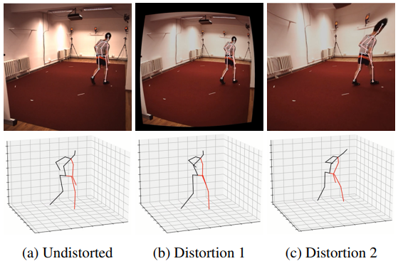
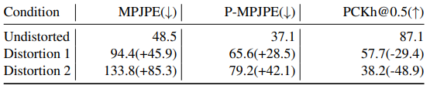
Introduction
Existing 3D human pose estimation algorithms trained on distortion-free
datasets suffer performance drop when applied to new scenarios with
a specific camera distortion.
Propose a simple yet effective model for 3D human pose estimation in
video that can quickly adapt to any distortion environment by utilizing
MAML, a representative optimization-based meta-learning algorithm.
Human3.6M
2

Slide 3
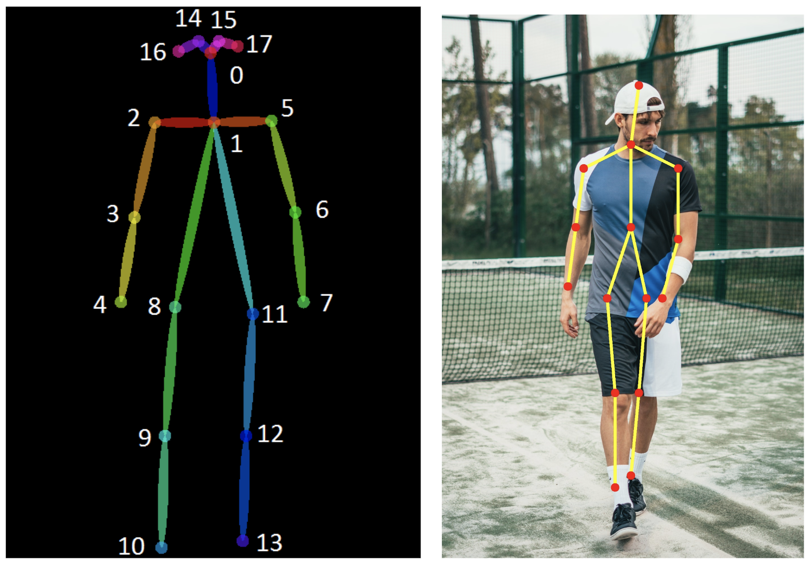
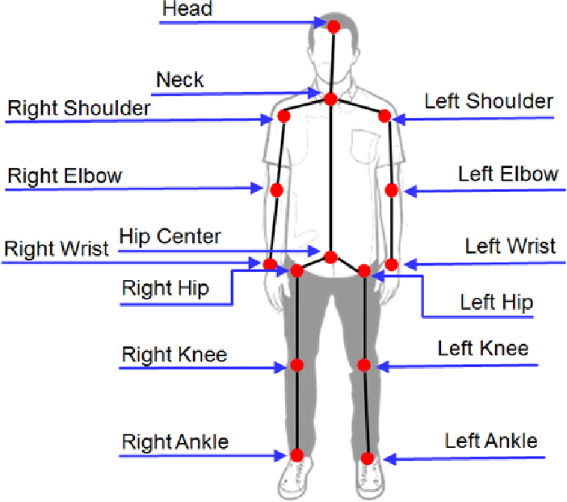
Preliminary
Background
〮 What is Human Pose Estimation?
: a way of identifying and classifying the joints in the human body.
3

Slide 4
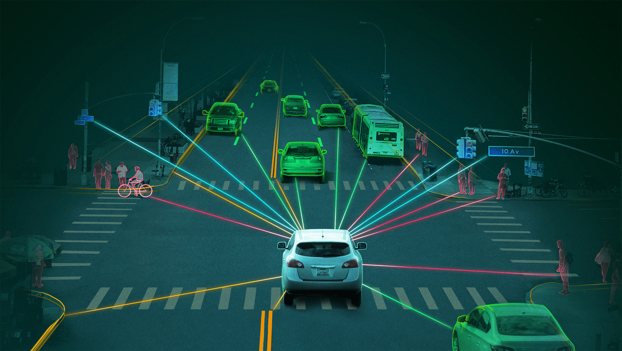
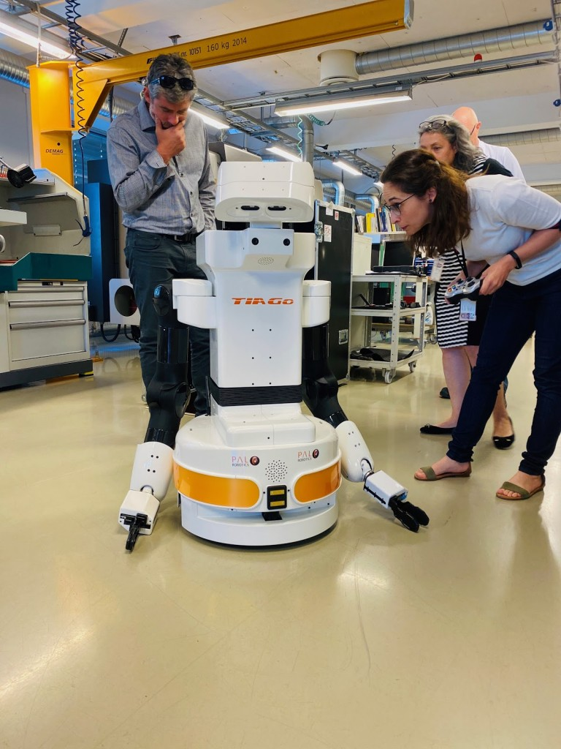
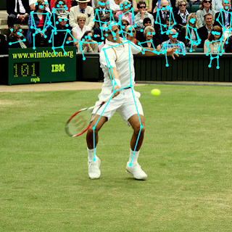
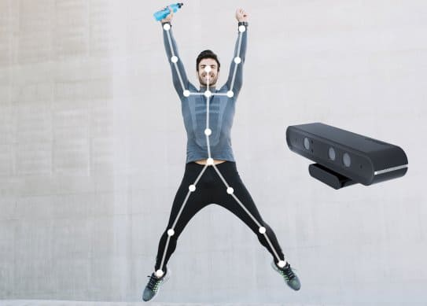
Preliminary
Background
〮 Human Pose Estimation Applications
: Autonomous driving, Robotics, Game, Sports etc.
?
4

Slide 5
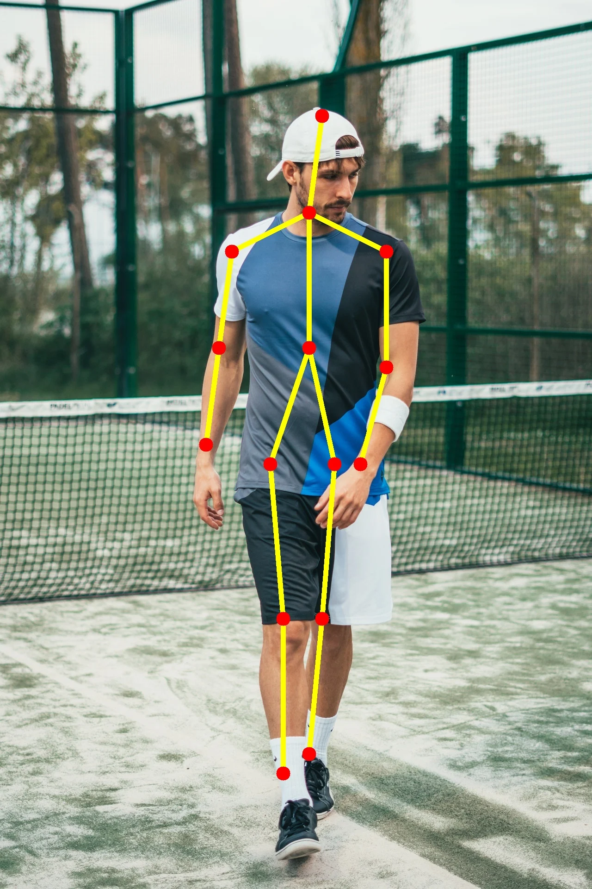
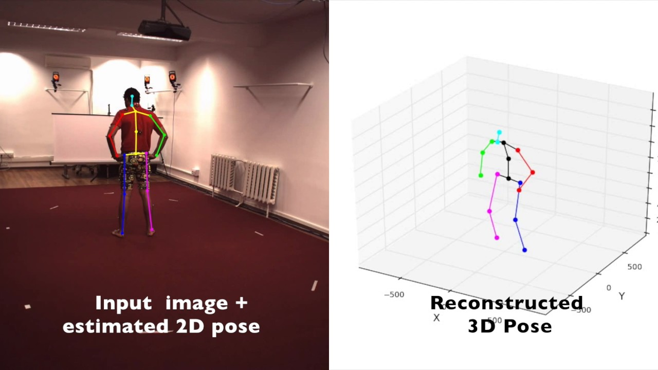
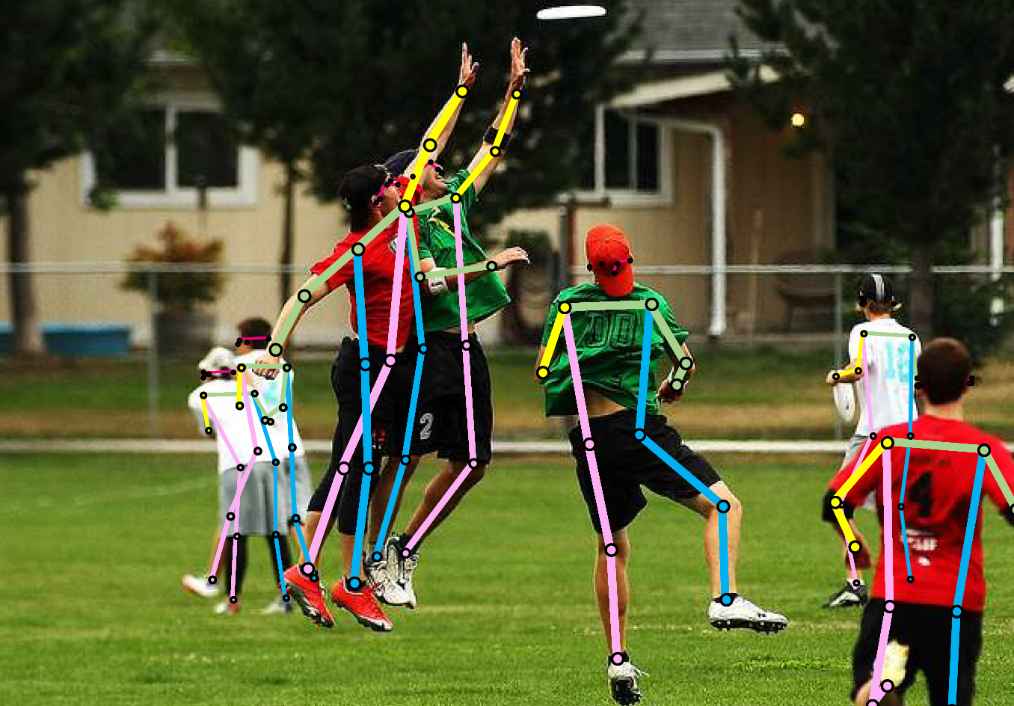
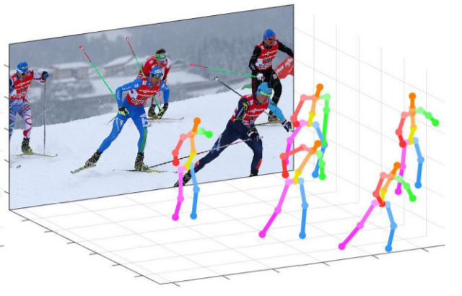
Preliminary
Background
〮 Techniques of Human Pose Estimation
 | 2D Pose | 3D Pose
Single- Person | Input : image | Input : image, depth
Multi- Person | Input : image | Input : image, depth
5

Slide 6
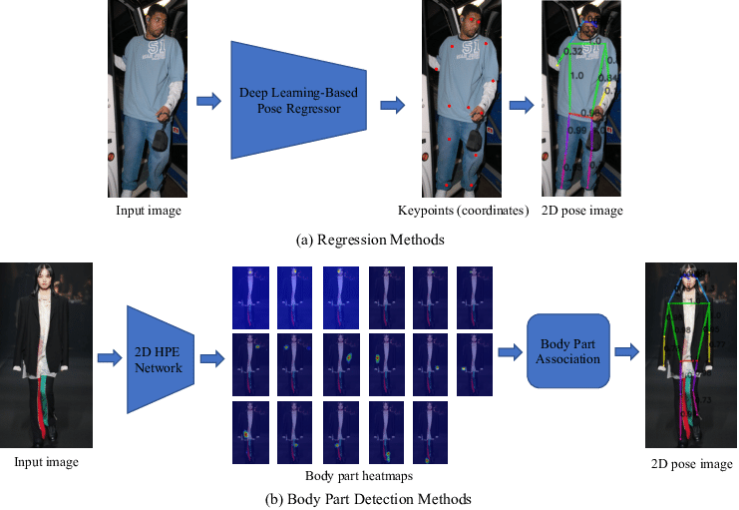
Preliminary
Background
〮 Approaches of single-person
Direct regression
Heatmap based
6

Slide 7
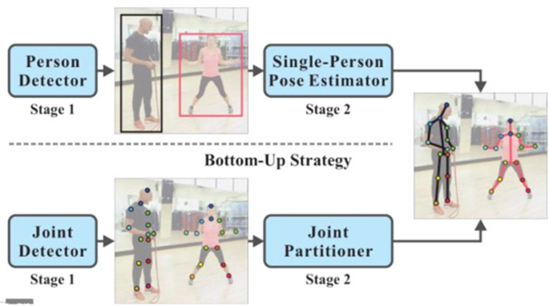
Preliminary
Background
〮 Approaches of multi-person
Top-down
Bottom-up
7

Slide 8
Preliminary
Background
〮 What is Meta-Learning?
If you’ve learned 100 tasks already, can you figure out how to
learn more efficiently?
- Meta-learning = learning to learn
〮 Why is meta-Learning a good idea?
Deep learning algorithms require a huge number of data.
If we can meta-learn a learner, we can learn new tasks efficiently.
8

Slide 9
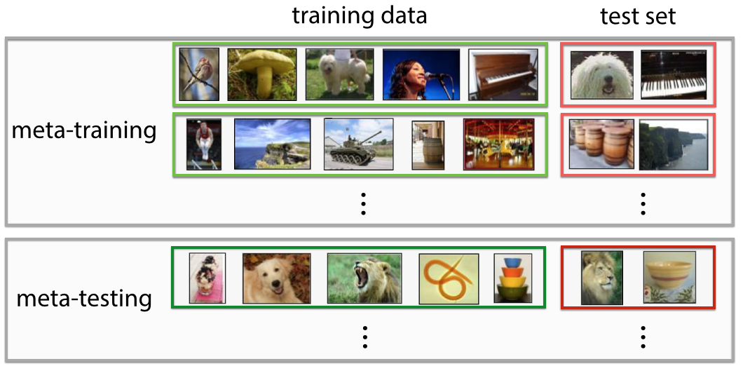
Preliminary
Background
〮 Meta-Learning with supervised learning
9

Slide 10
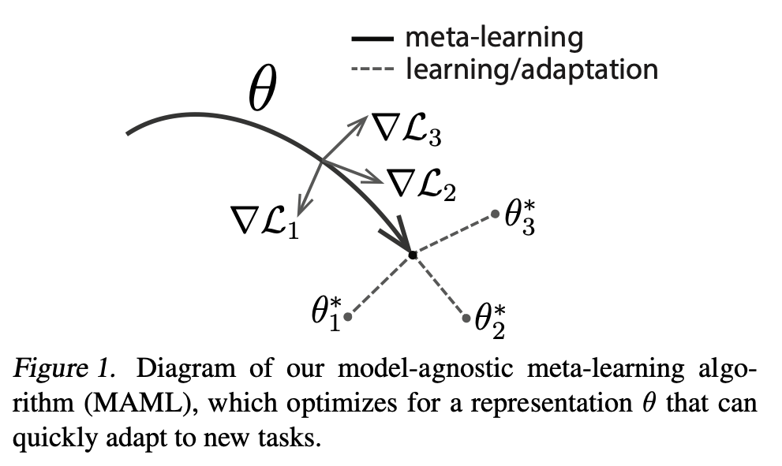
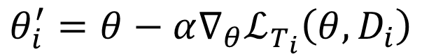
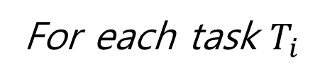
Preliminary
Background
〮 MAML (Model-Agnostic Meta-Learning)
Chelsea Finn, Pieter Abbeel, Sergey Levine:
Model-Agnostic Meta-Learning for Fast Adaptation of Deep Networks (5679 quotes)
For each task $T_{i}$
$$θ_{i}^{′}=θ−α∇_{θ}ℒ_{T_{i}}\left(θ, D_{i}\right)$$
10

Slide 11
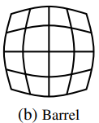
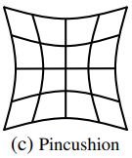
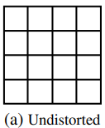
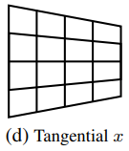
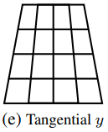
Preliminary
Background
〮 Camera Distortion
- There are two kinds of camera distortion.
Radical distortion
Tangential distortion
11

Slide 12
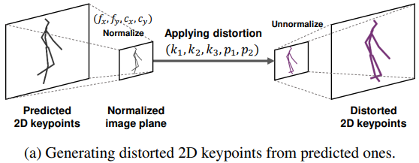
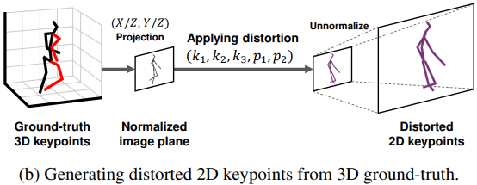
Method
Synthetic Distorted Task Generation
12

Slide 13
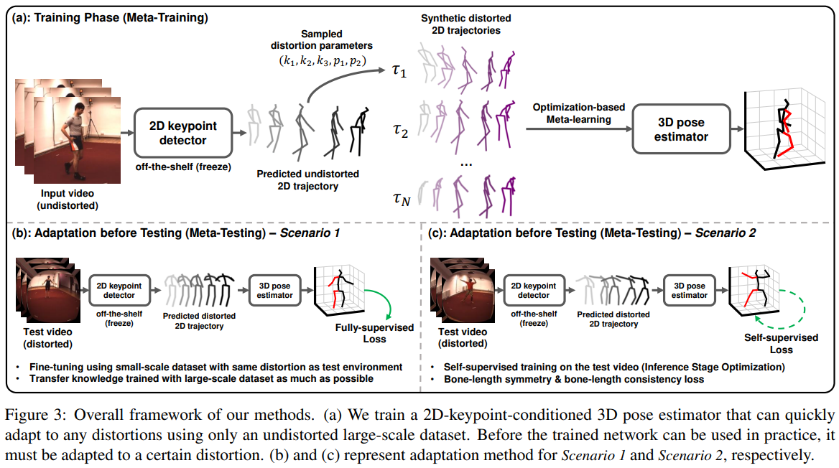
Method
Overall Framework
13

Slide 14
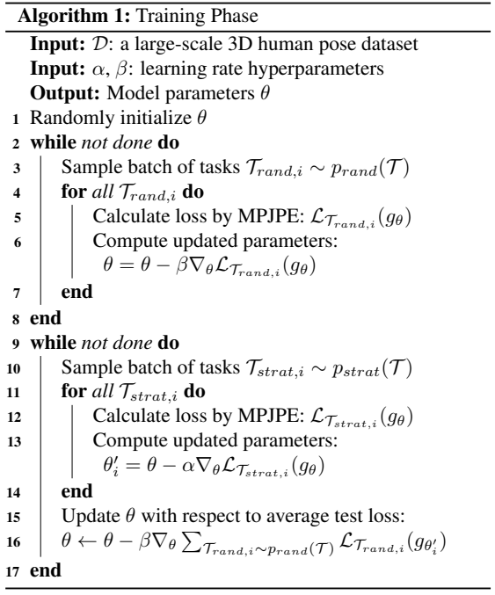
Method
Algorithm
random
distortion
pretraining
Task-level training
Task-level testing
14

Slide 15
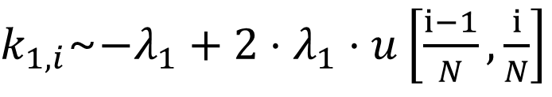
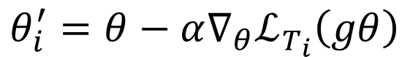
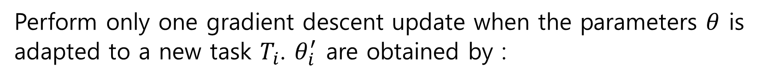
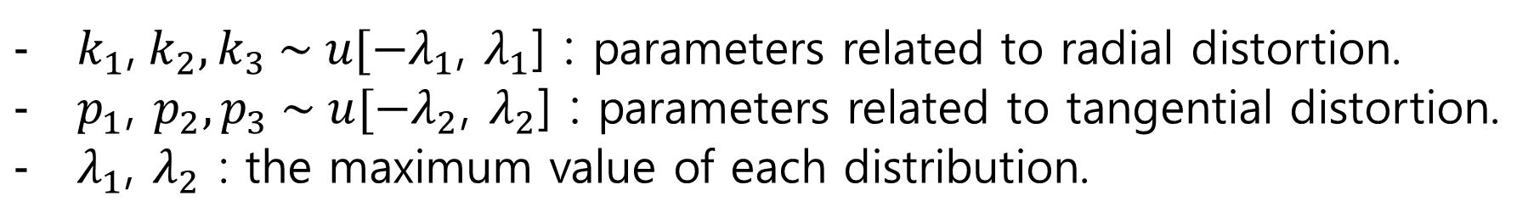
Method
A $k_{1}$ of $i$th sample in the meta-batch is sampled as follow :
$k_{1}$,${ k}_{2},k_{3} \sim u[−λ_{1}$, $λ_{1}$] : parameters related to radial distortion.
$p_{1}$, $p_{2},p_{3} \sim u[−λ_{2}$, $λ_{2}$] : parameters related to tangential distortion.
$λ_{1}$, $λ_{2}$ : the maximum value of each distribution.
$k_{1,i}$~$−λ_{1}+2⋅λ_{1}⋅u\left[\frac{ⅈ−1}{N},\frac{ⅈ}{N}\right]$
Perform only one gradient descent update when the parameters $θ$ is
adapted to a new task $T_{i}$. $θ_{i}^{′}$ are obtained by :
$$θ_{i}^{′}=θ−α∇_{θ}ℒ_{T_{i}}\left(gθ\right)$$
15

Slide 16
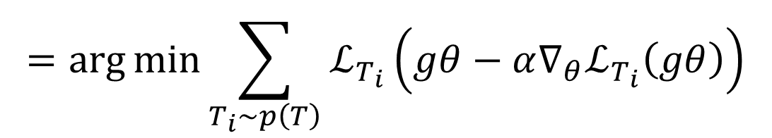
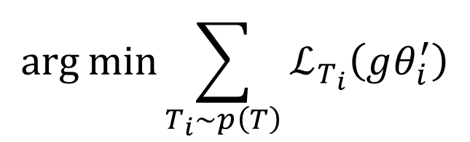

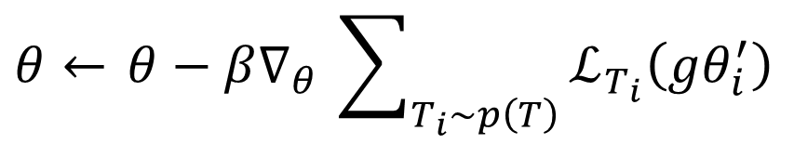
Method
The mata-objective is expressed as follows :
$$\arg{\min{\sum_{T_{i}\sim p\left(T\right)}{ℒ_{T_{i}}\left(gθ_{i}^{′}\right)}}}$$
$$=\arg{\min{\sum_{T_{i}\sim p\left(T\right)}{ℒ_{T_{i}}\left(gθ−α∇_{θ}ℒ_{T_{i}}\left(gθ\right)\right)}}}$$
For the stochastic gradient descent, model parameters $θ$are updated
as follows :
$θ←$ $θ−β∇_{θ}$ $\sum_{T_{i}\sim p\left(T\right)}{ℒ_{T_{i}}\left(gθ_{i}^{′}\right)}$
16

Slide 17
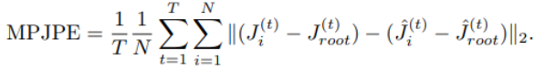
Evaluation Metrics
〮 MPJPE (mean per joint position error)
: the L2 distance between ground-truth 3D joints and predicted ones
〮 P-MPJPE : calculates the error between the joints after alignment
using Procrustes Analysis
〮 PCkh@0.5 : percentage of correct 3D joints with a threshold as 50%
of the head segment length
17

Slide 18
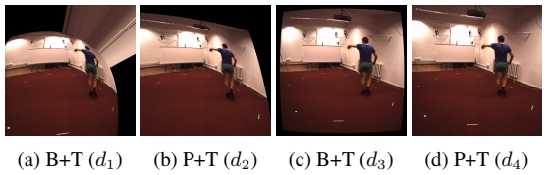
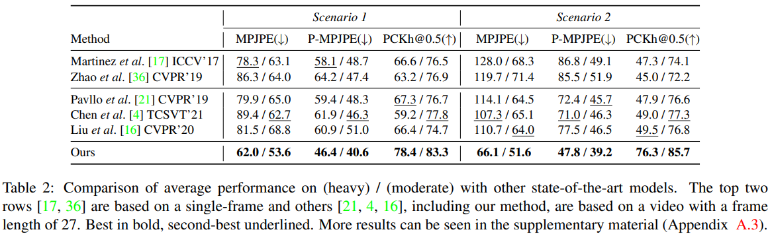
Results
Comparison with State-of-the-Art
The proposed method outperforms other methods regardless of
the kinds of distortions and scenarios.
18

Slide 19
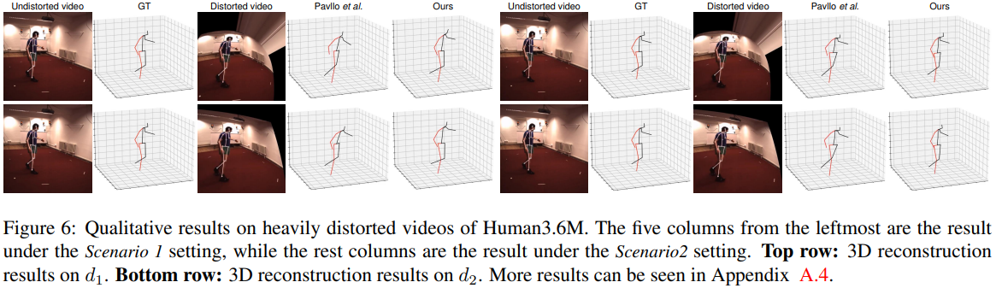
Results
Comparison with State-of-the-Art
19

Slide 20
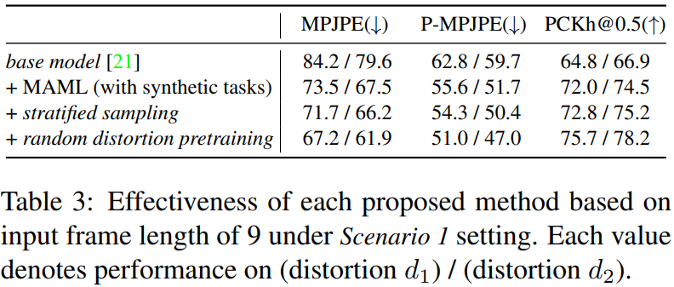
Results
Ablation Studies
Notice that each method provides a positive contribution under
all metrics
20

Slide 21
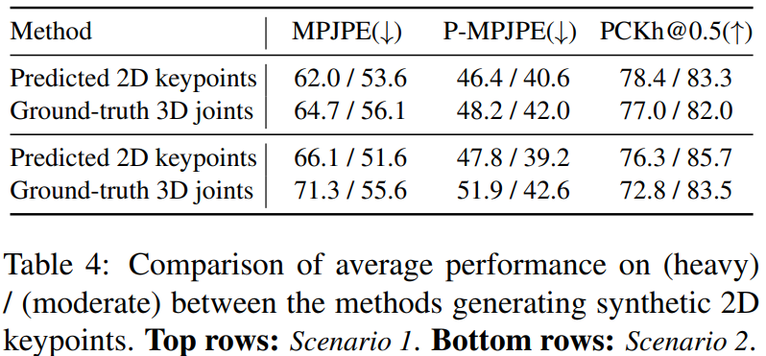
Results
Ablation Studies
Notice that the former method shows better performance under all
metrics and scenarios since there is less domain gap between
training and testing.
21

Slide 22
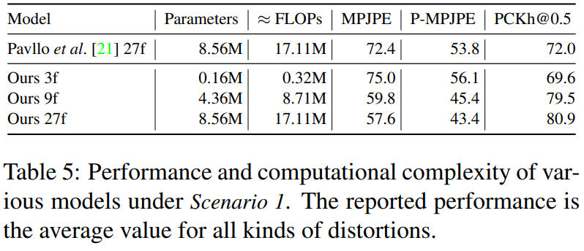
Results
Ablation Studies
No additional computational cost is required compared to the base
model when testing after adaptation to the test environment
22

Slide 23
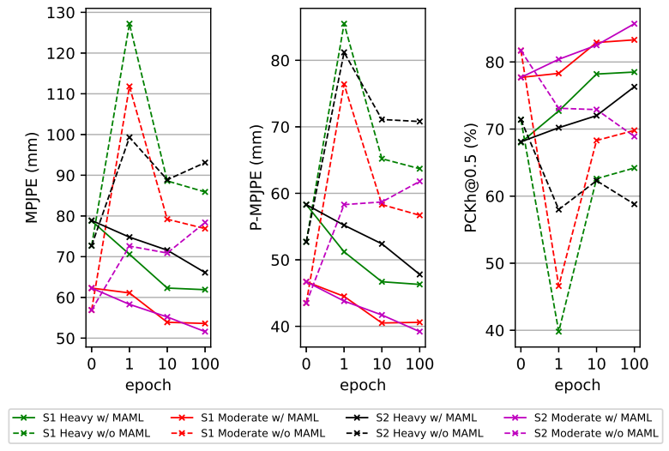
Results
Performance Changes during Adaptation
Demonstrate the superior potential of MAML to adapt to various
distortion environments.
23

Slide 24
Thank you

Slide 25
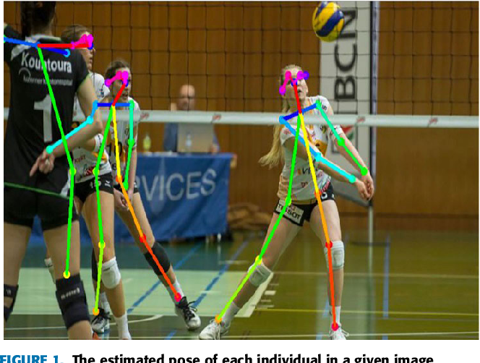
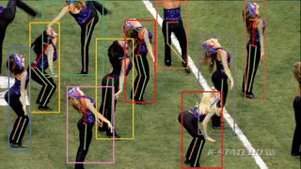
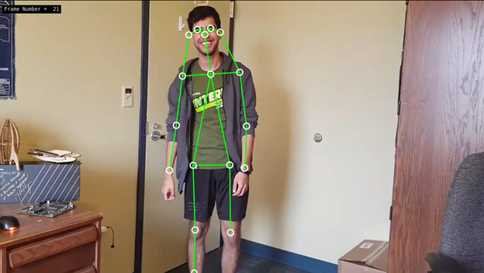

Slide 26
